Slide 1


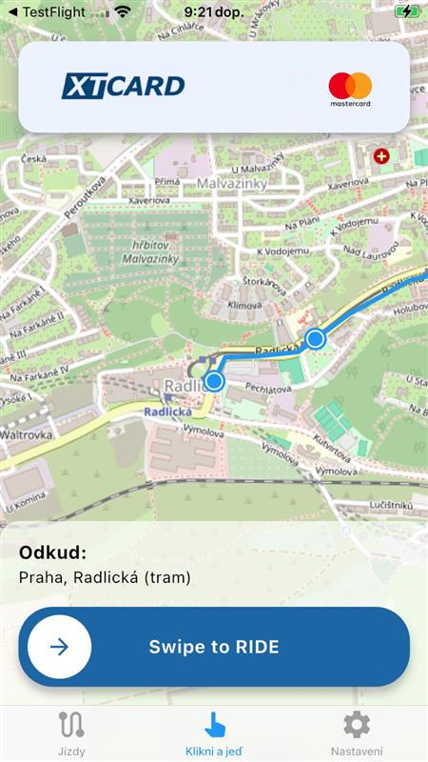
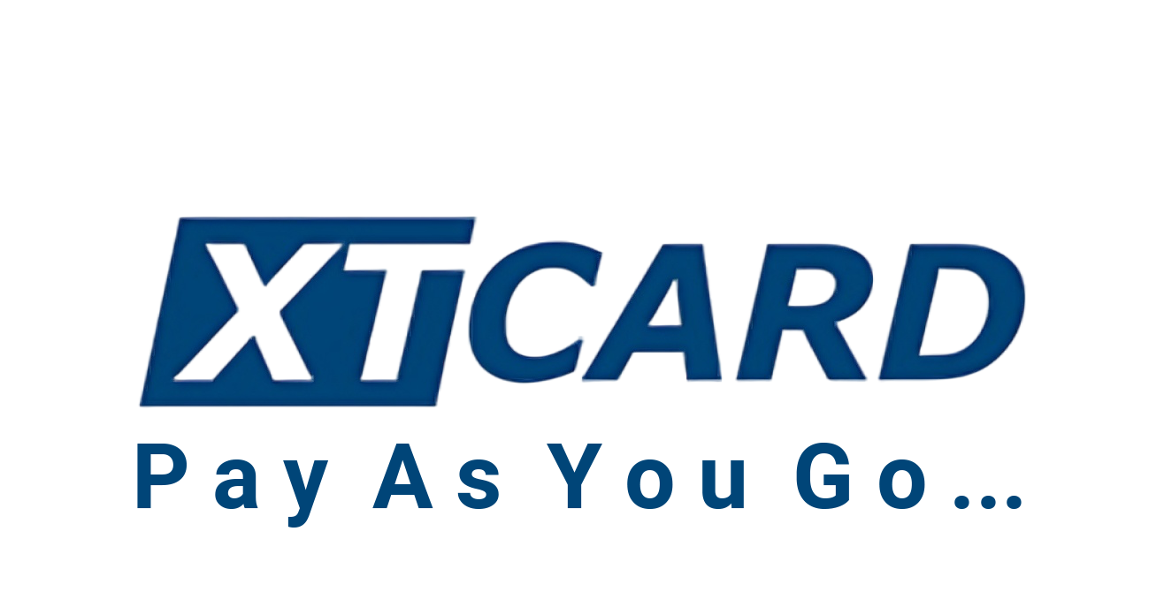

Slide 2
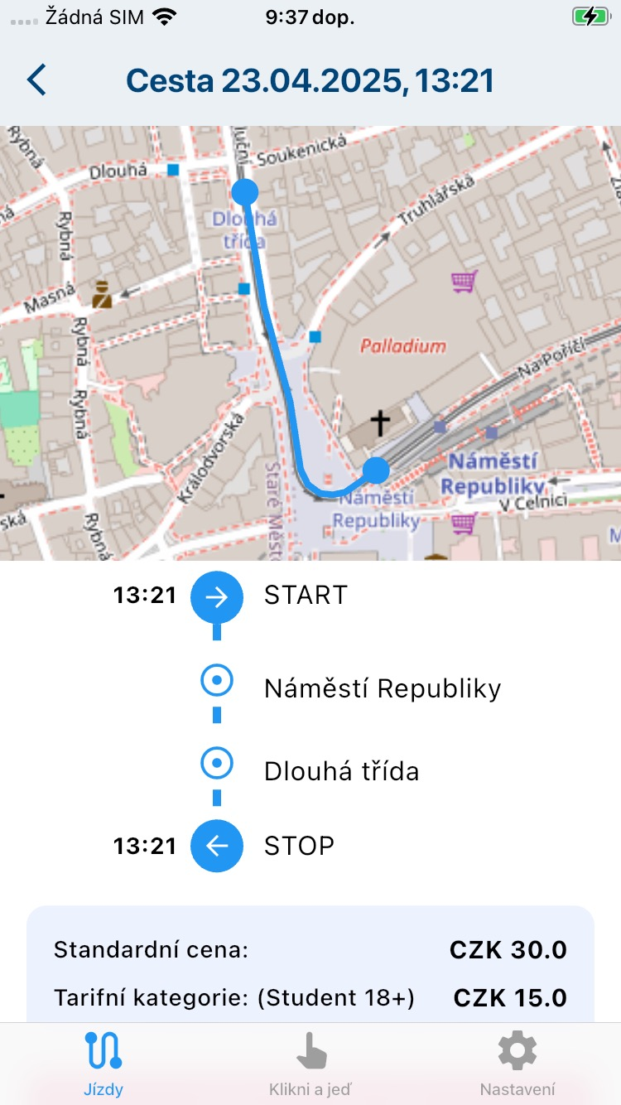

Introducing the concept
Tap and ride …
Virtual pay-as-you-go ticketing allows passengers to travel within a transport network without buying tickets in advance. The user starts the mobile app, which tracks their route using GPS, and stops ticketing when the journey ends.
The system then calculates the fare based on the distance travelled and the applicable tariff, and automatically processes the payment. This approach offers greater flexibility and convenience: passengers pay only for the distance actually travelled, without having to deal with paper tickets or understand the tariff beforehand.

Slide 3
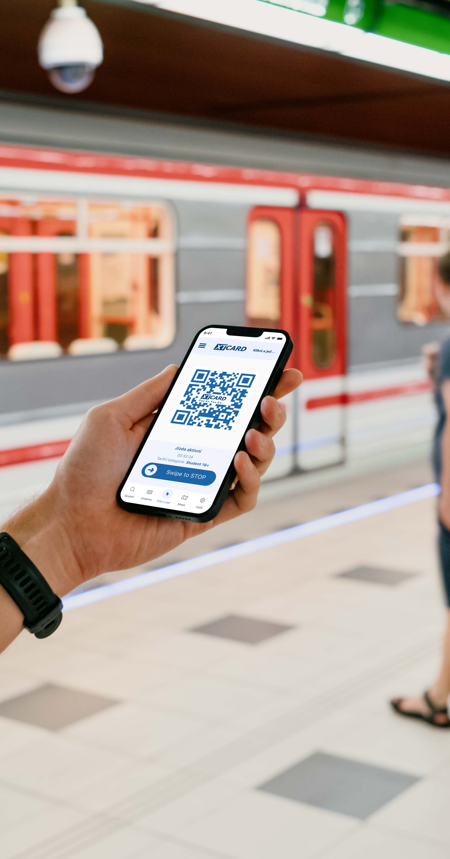
A new standard in
transport ticketing
A simple way to travel without knowing the tariff or worrying about ticket duration and zone validity. No advance payment is required: you pay only for the route actually travelled, always at the lowest possible fare. Daily capping ensures that the total never exceeds the price of the relevant day ticket.
This type of virtual Pay-As-You-Go ticketing, also known as TAP IN/OUT, is gradually becoming standard in many modern European cities and in nationwide fare systems, for example in the Nordic countries.

Slide 4


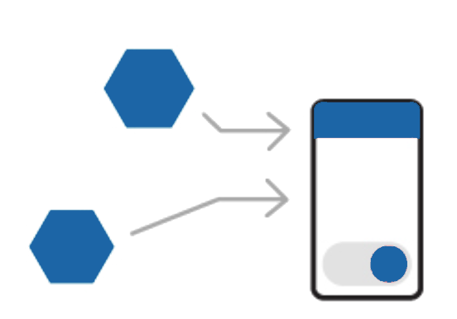


Ticketing process
02
04
01
03
05
Back-End
Secure QR code
Data is sent to central servers for further processing
The server provides a QR code for passenger validation and ticket inspection devices
START
Data collection
STOP
The passenger starts a journey - Check-IN
The app collects journey data from GPS, Wi-Fi, speed and time sensors
The passenger ends a journey - Check-OUT

Slide 5
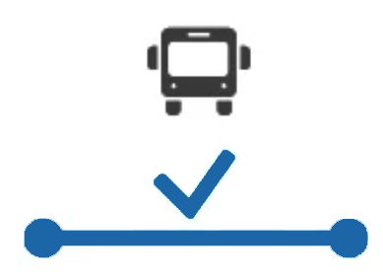
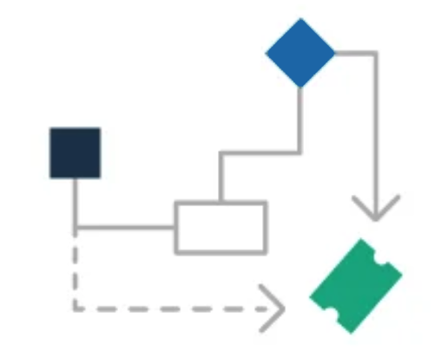
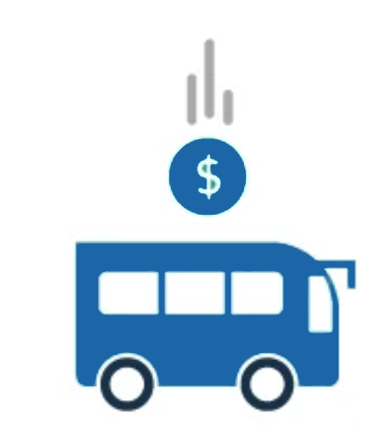


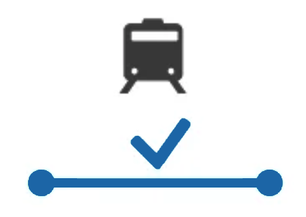

Ticketing process
07
09
06
08
10
Settlement
Route reconstruction
The passenger is charged for the day's travel, with daily capping applied
AI and machine learning reconstruct the entire journey, including stops, services and times
Fare calculation
Clearing
Data cleansing
The fare is calculated from the reconstructed route and available tariff data
Funds are transferred to carriers or transport network operators
Inconsistencies and logical errors are removed from the data

Slide 6
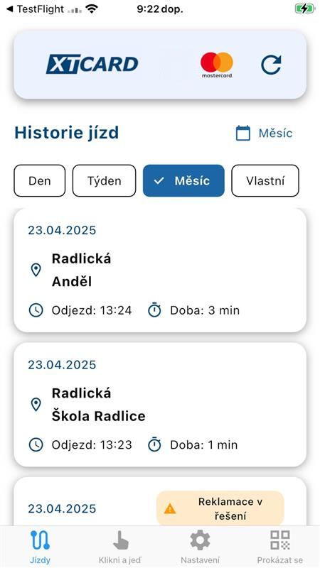

A complete travel overview
No fare expertise needed
Using data collected during the journey and machine learning, the app reliably reconstructs the passenger's entire route, including transfers and breaks. Users receive a clear summary of their journeys, with a map and the fare for each journey, reflecting their passenger category and any other applicable discounts.
AI
Modern machine learning and AI technologies not only reconstruct the route reliably, but also detect various types of fraud, correct passenger data and intelligently recognise the mode of travel and means of transport used.

Slide 7

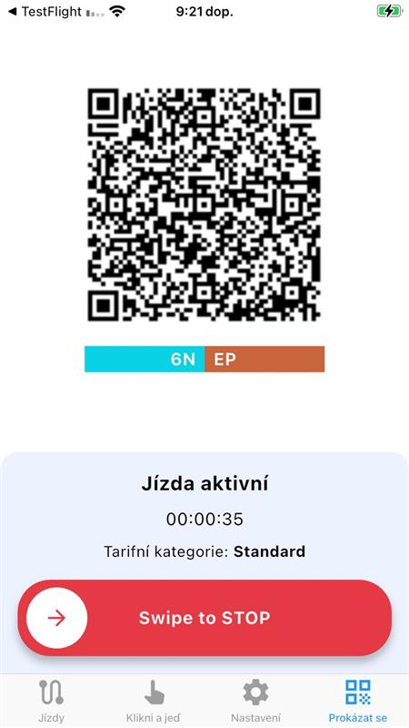


Low costs for
Solution deployment
No hardware changes needed
The system will be able to work without changes to existing ticketing equipment by using the standard already implemented in the network.
The app generates a secure QR code when a journey starts. This code can be tailored to the relevant fare system and use a standard already implemented in that network, such as a day ticket created virtually for validation purposes. Actual settlement takes place at the end of the day, based on the journeys made.
TAP IN/OUT from scratch
Transport networks without TAP IN/OUT can implement the solution without buying or upgrading expensive on-board hardware, while retaining the same ticketing principle and passenger functionality.

Slide 8
Smart features
The system will offer several smart features to maximise automation for both customers and operators. For operators, these functions reduce costs and prevent problems. For customers, they provide a positive user experience.
Fraud management
Multiple fare systems
SDK KIT
SMART START/STOP
Connected transport networks
Universal app, White-label app
Automatic fare calculation
Daily capping
Detailed public transport usage data
AI route calculation
Apple Pay/Google Pay
Full clearing for operators

Slide 9

Passenger comfort
The app and the overall solution focus primarily on the end user and their comfort when travelling on local and integrated public transport. Users will be able to use the same kind of solution found in modern cities around the world.
SMART START/STOP
Universal app
Simple payment management
The app automatically detects when a passenger starts or ends a journey and notifies them if TAP IN/OUT is not active. It can also automate these actions so that users do not pay more than the fare for their actual travel.
The XTC (Do Kapsy) app can support multiple fare systems in a single application. Wherever users travel, they can use a familiar app without having to register again.
Alongside standard card payments, users will have access to Apple Pay and Google Pay. They will be able to manage personal and business journeys using different cards and separate tax receipts for straightforward expense accounting.

Slide 10

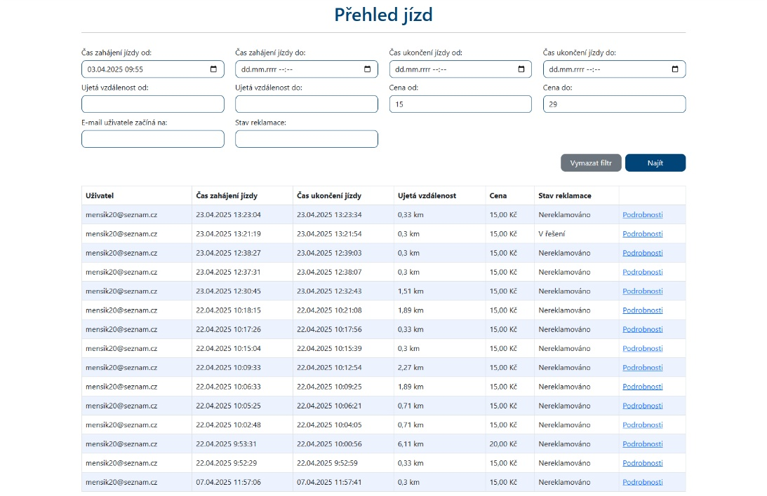
Administration portal
Back office
The solution will include an extensive administration portal and a back-office module to help customer support resolve complaints, including incorrectly calculated routes and payment issues. By its nature, the system may calculate a proportion of routes incorrectly because of fare exceptions, service disruptions and other circumstances. Customer support therefore needs effective tools to investigate the problem and resolve each request to the customer's satisfaction.

Slide 11

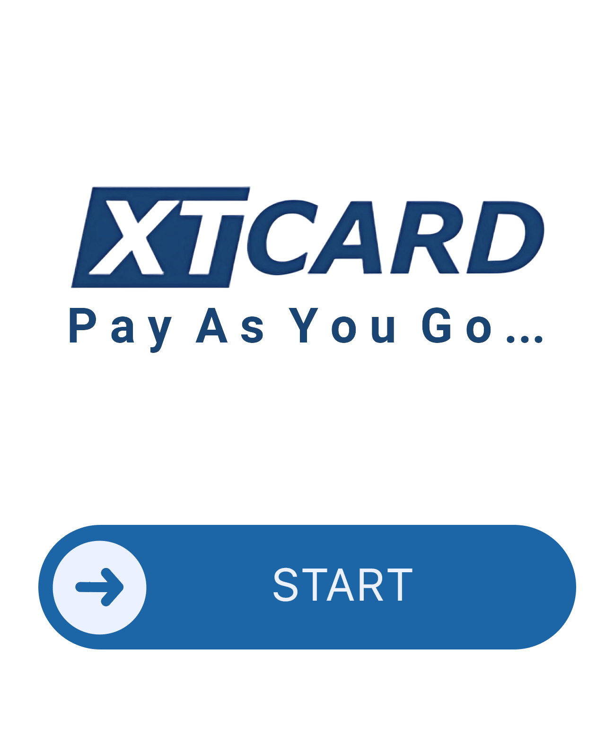
Smartwatch
Ready
The entire solution can be easily implemented on smartwatches. Passengers can start or stop a journey and display a QR code for ticket inspection or validation directly on their watch, without taking out their mobile phone.

Slide 12

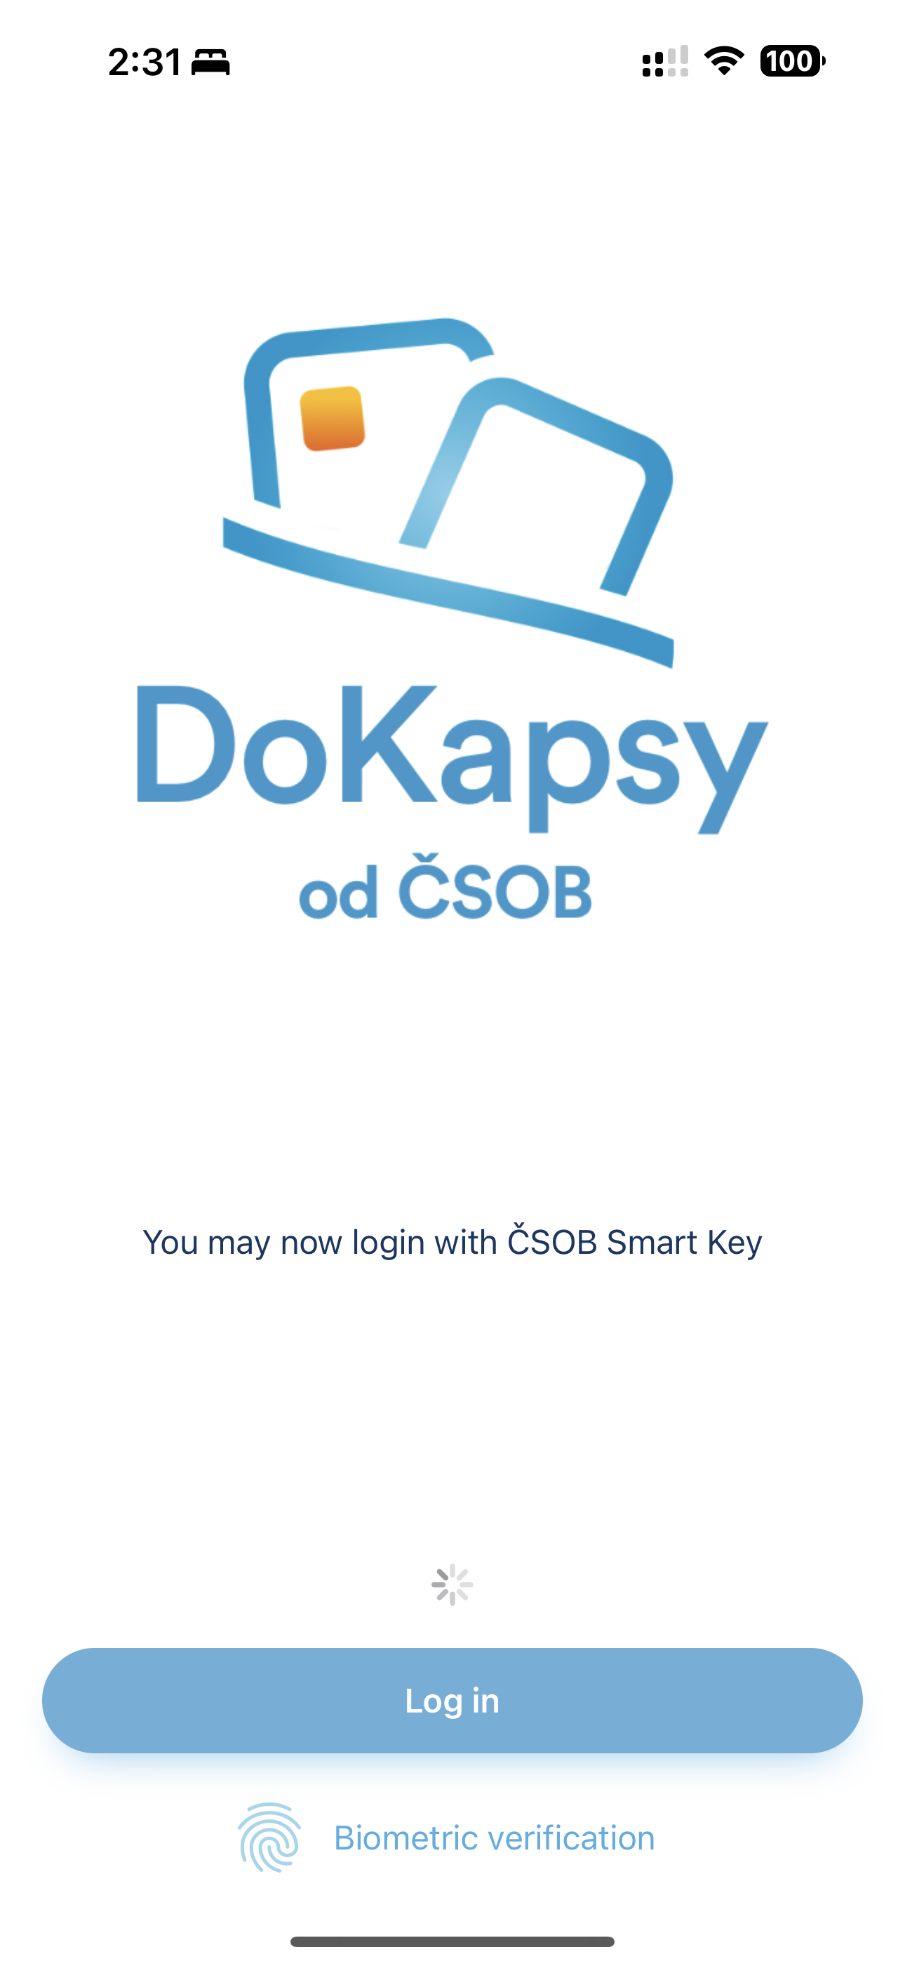


SDK KIT
The SDK packages the application into an implementation kit that can be integrated into existing third-party apps through a documented interface.
Existing transport apps can add XT-Card Pay As You Go alongside their current functionality and fully integrate the system into their ecosystem, including customised branding. The SDK handles the complete functionality, security and processes, just as a standalone app would.
SDK
READY
Full integration
Flexibility
Transport operators and integrators do not need to launch another separate app. Passengers can access all the functionality in the solution they already know.
XT-Card Pay As You Go can serve both networks without an existing mobile app and those that already have one. The flexibility of XTC Pay As You Go integration offers a wide range of deployment options.

Slide 13
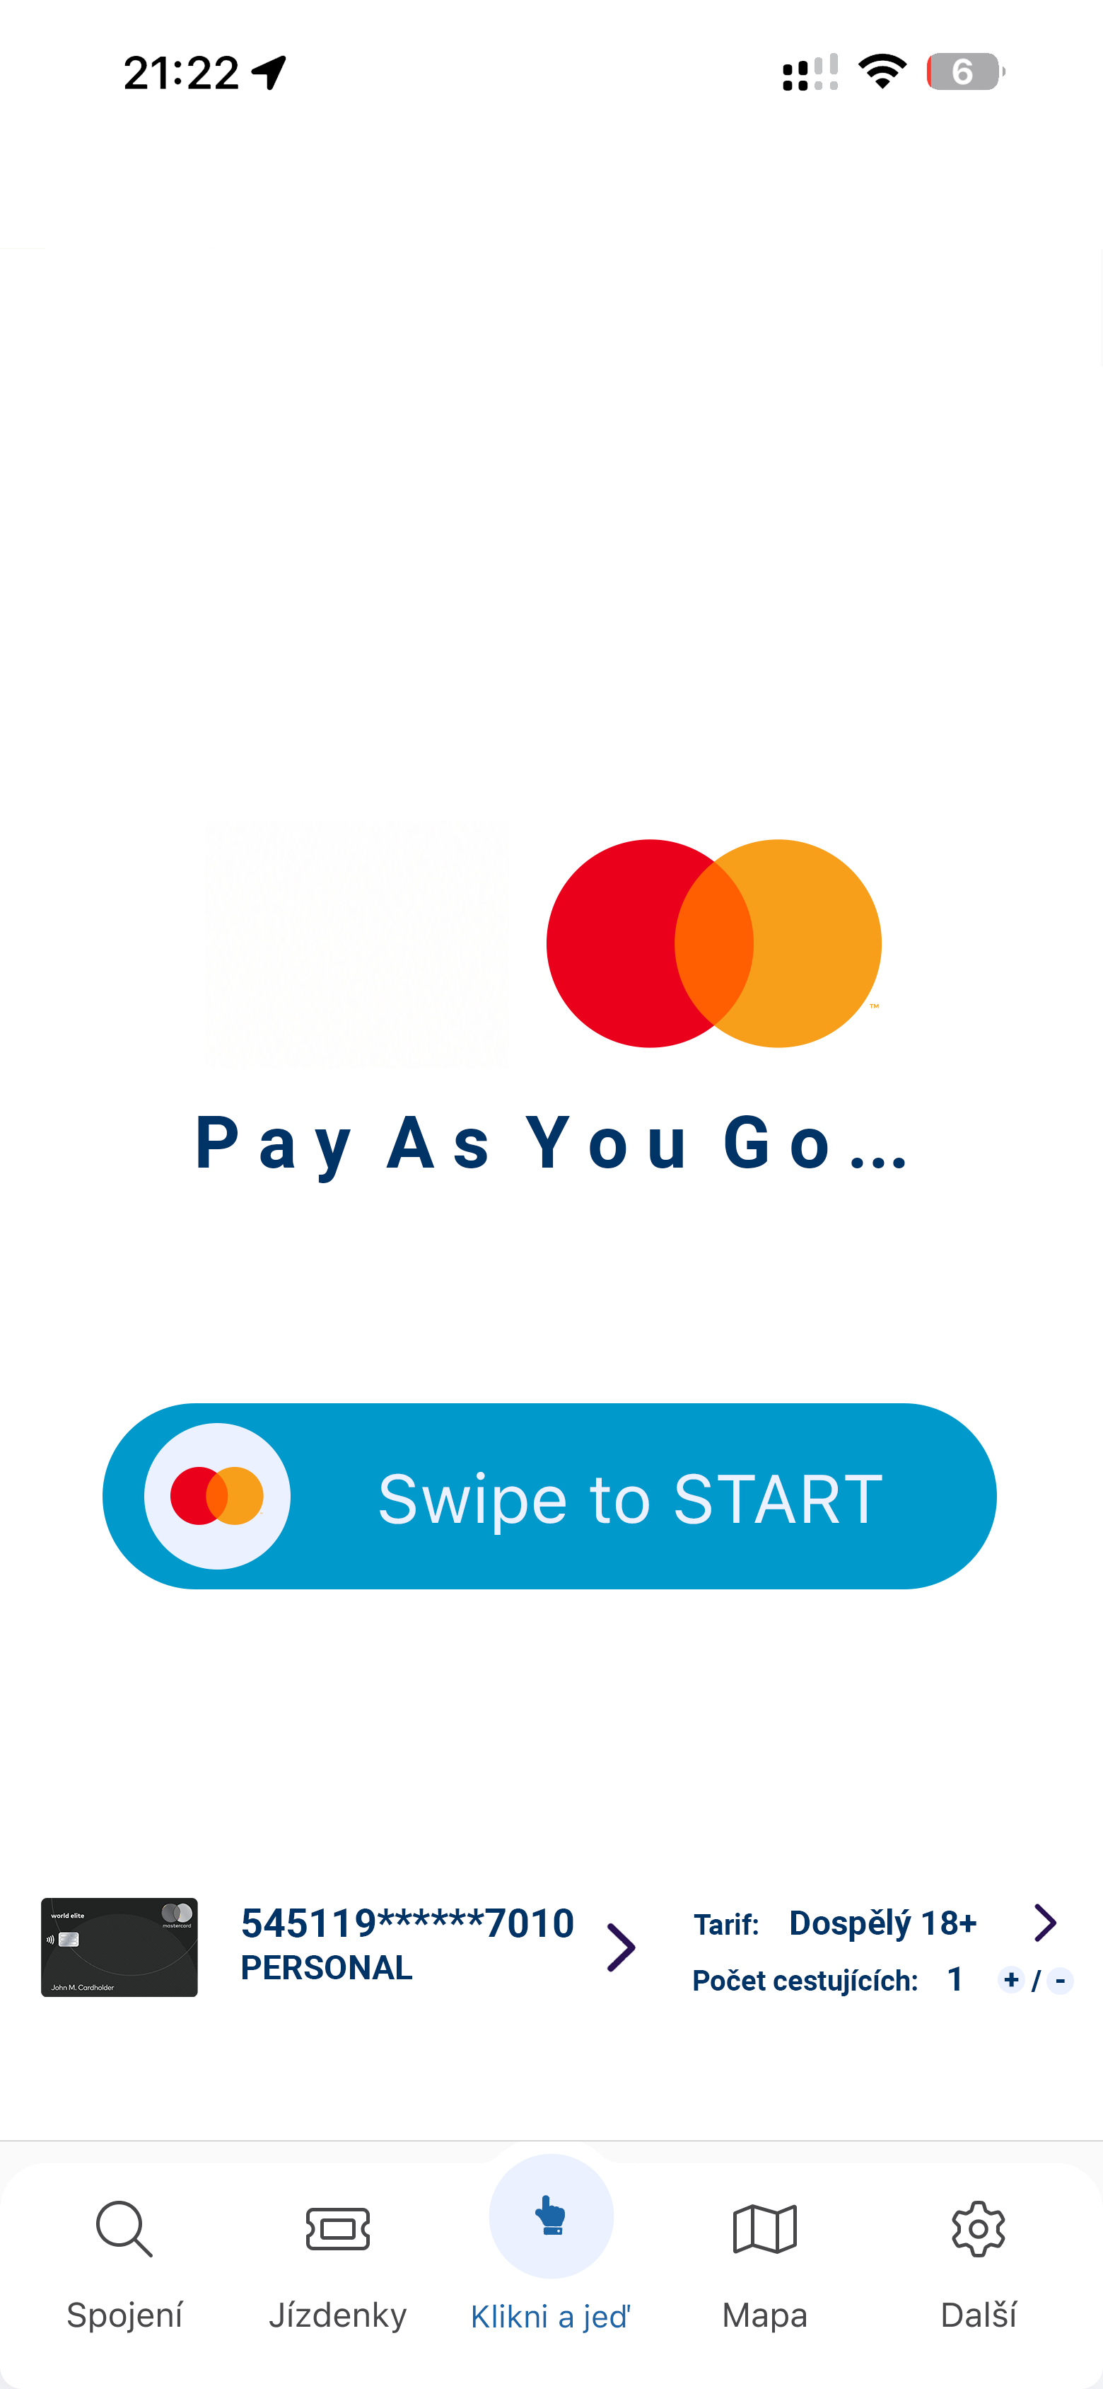


Branding Mastercard
Travel smarter with Mastercard …

Slide 14
XT-Card
a.s.
XT-Card a.s. is a Czech specialist in contactless card systems for transport, payments and identification. Its team of 20+ professionals builds on more than 20 years of experience. With over one million users, the company develops tailored solutions for national, regional and local transport networks.
Notes:
Source: https://xt-card.com/o-nas/ (accessed 3 November 2026). Figures published by XT-Card.

Slide 15
Proven
experience
XT-Card combines card management, mobile apps, e-shops and revenue clearing with experience in complex system integration. Its projects include Czech Railways' In-karta, IREDO and the ODIS card ecosystem. Customers value its responsive support, professional approach and reliable delivery.
Notes:
Sources: https://xt-card.com/o-nas/ and https://xt-card.com/systemy-pro-moderni-dopravu/ (accessed 3 November 2026). Project descriptions and customer feedback published by XT-Card.

Slide 16
Thank you
Ing. Martin Rejzl

